Slide 1
Front End Engineering-I Project
Sr No. Name Roll No.
1 Manan Sharma 2310990729
2 Manav Gupta 2310990730
3 Manisha 2310990731
Faculty Incharge: Dr. Harveen Kaur
:
Chitkara University Institute of Engineering and Technology,
Chitkara University, Punjab

Slide 2
Table of Contents
Introduction
Problem Statement
Technical Details
Key Features
Project Highlights
Conclusion
References/Links Used

Slide 3
Introduction
An Application that lets you manage all your contacts in one place.
Provides a reliable and persistent storage for the key information related to your contacts.
Simple UI and essential features to add and modify the contacts.
Address Book lets you store name, address , e-mail, phone numbers.
You can directly call a number from a contact.
At least on phone number (phone1) is mandatory.
Multiple Contacts with same phone number are not allowed.

Slide 4
Problem Statement
Are u tired of searching through endless stacks of business cards , scribbled notes and outdated contact lists? Let’s explore how an address book can solve this common problem. This application aims to offer a unified platform with advanced features such as synchronization across devices, integration with communication tools, intelligent search capabilities, and an intuitive user interface.

Slide 5
Technical Details
HTML Used various tags like style tag , div tag
tag, anchor tag, nav tag, form, button tag
CSS Used different containers, flex, text
color, background color
VS CODE Used VS CODE for typing code using
HTML and CSS

Slide 6
Key Features
Contact Management
Easily add, edit, and delete contacts with options to organize them into groups or categories.
Search and Filter
Quickly find specific contacts based on various search criteria, such as name, address, or phone number.
User-Friendly Interface
The address book provides a clean and intuitive user interface, ensuring ease of use for individuals of varying technical proficiency. Clear labels, input fields, and a straightforward design contribute to a positive user experience

Slide 7


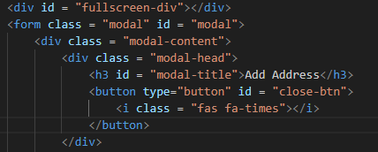
Project Highlights
Html Code

Slide 8
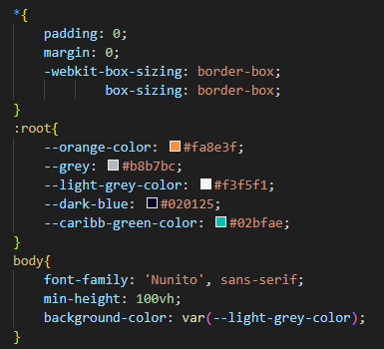
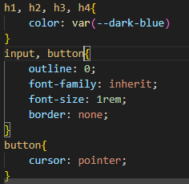
Project Highlights
CSS Code

Slide 9
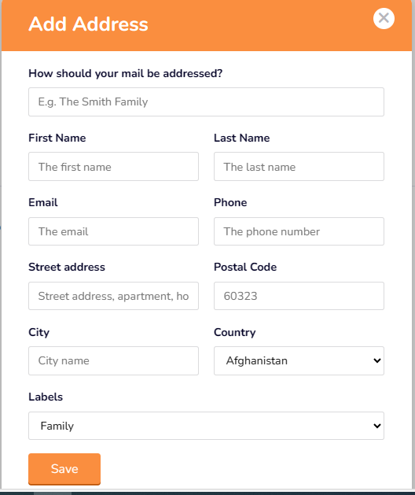
Project Highlights

Slide 10

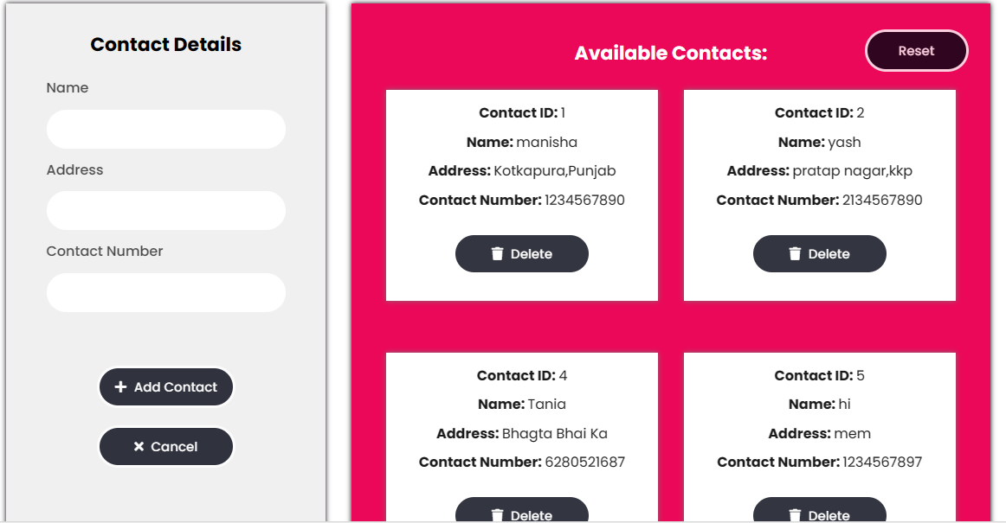
Project Highlights

Slide 11

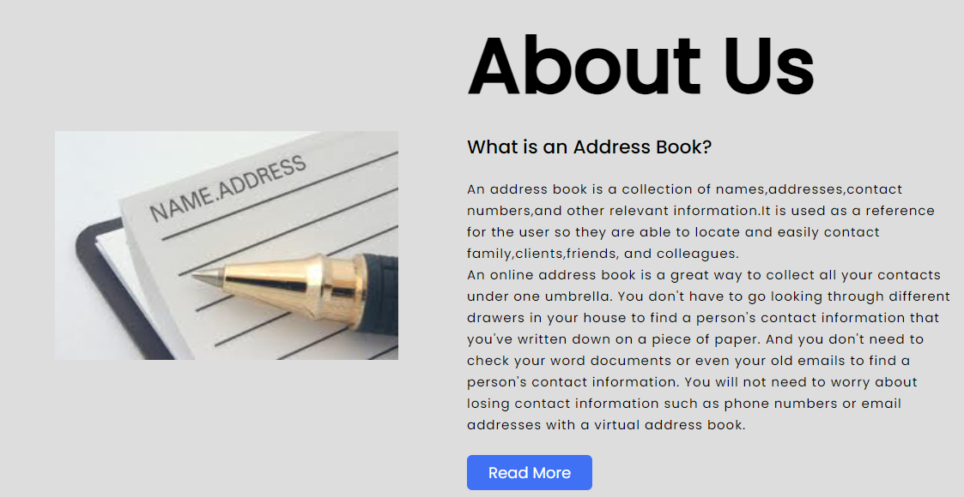
Project Highlights

Slide 12
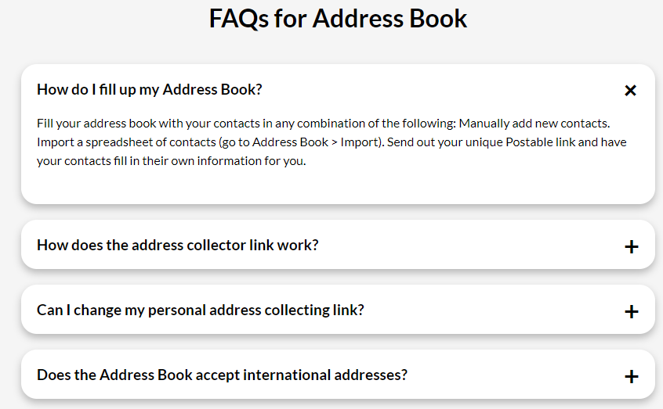
Project Highlights

Slide 13
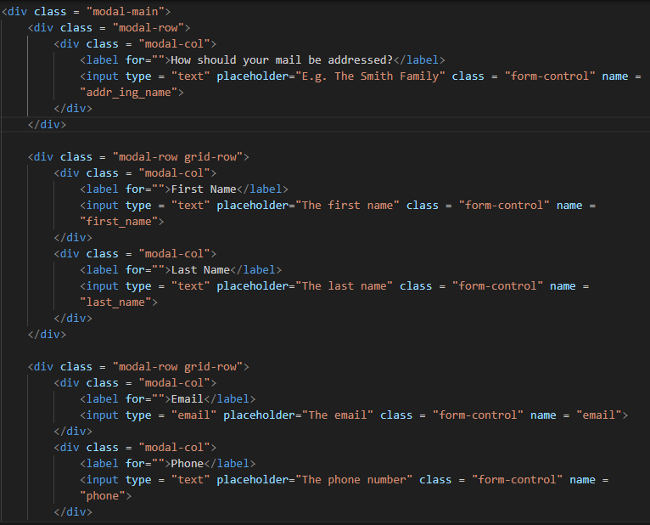
Project Highlights
Html Code

Slide 14
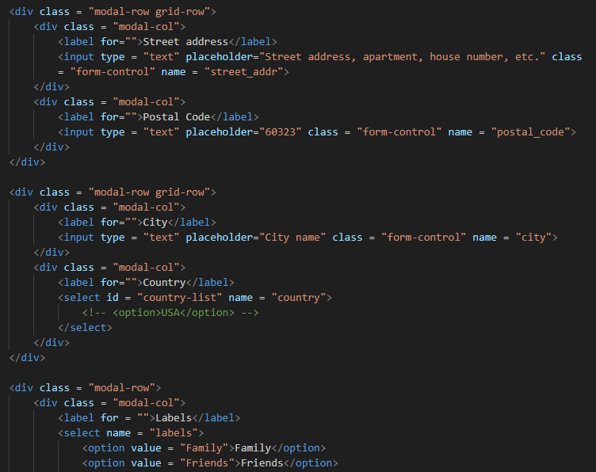
Project Highlights
HTML Code

Slide 15
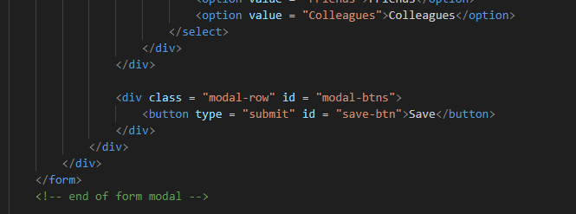
Project Highlights
HTML Code

Slide 16
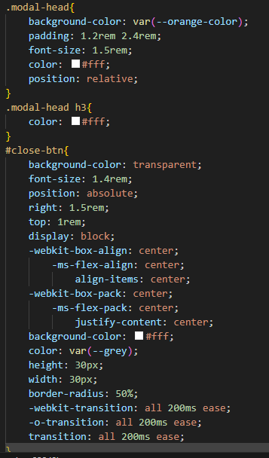
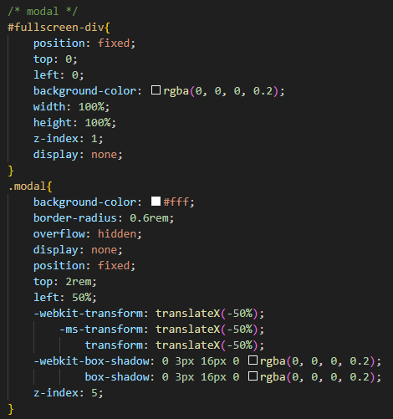
Project Highlights
CSS Code

Slide 17
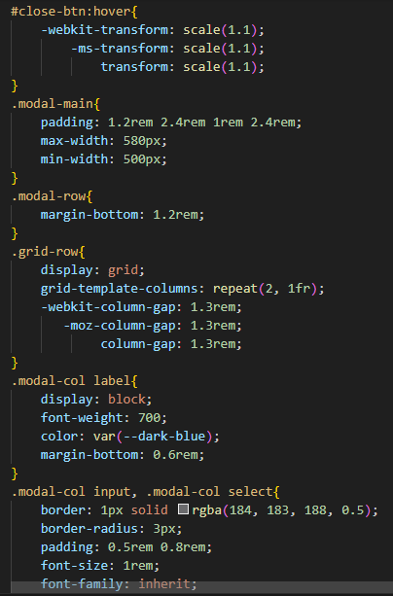
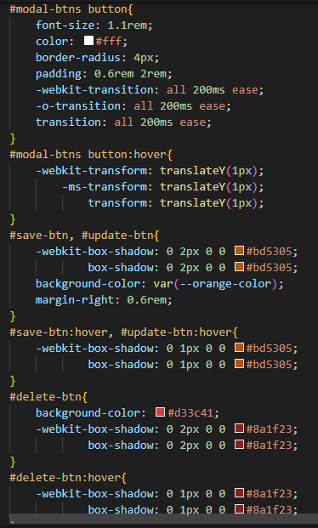
Project Highlights
CSS Code

Slide 18
Conclusion
An address book is an indispensable tool for efficient contact management, providing structure, accesibility , and enhanced communication. Start organizing your contacts today!

Slide 19
References/Links used
Link to get Address:
https://www.learnhowtoprogram.com/intermediate-javascript/object-oriented-javascript/address-book-user-interface
https://codepen.io/sola/pen/GyOReX
https://www.learnhowtoprogram.com/intermediate-javascript/object-oriented-javascript/address-book-user-interface
https://youtu.be/hlwlM4a5rxg?si=UHkiRgBml1npuunh

Slide 20


